Slide 1
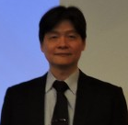
Medical Institutions
Psychiatric Medical Centers, MOHW
Yeh Da-cheng Breast Medical Group

Slide 2
Medical Institutions

Slide 3
Teaching Institutions

Slide 4
Business Partners (I)
Curdoctor Information Service Corp.
福寶科技
Healthcare /Hospital Information System (HIS)

Slide 5
Business Partners (II)
Life Star

Slide 6
Business Partners (III)
CORIGN
Ho-Li Medical Management Consulting Co., Ltd

